Slide 1
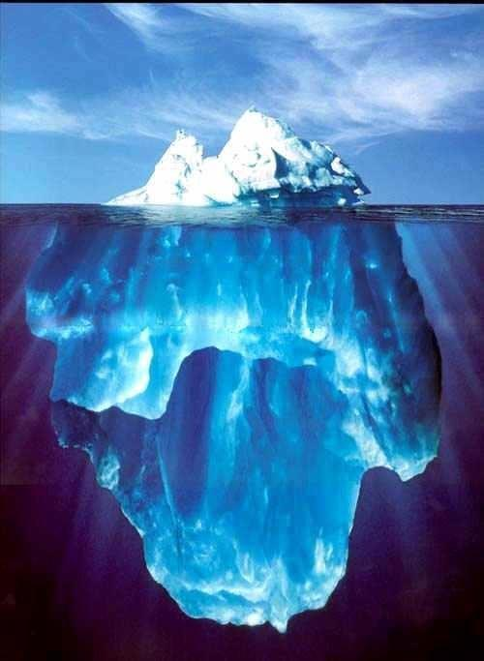

The Unconscious
[Instructor Name]
[Class and Section Number]
Notes:
We recommend this class be taught over a single period.
To generate discourse, we recommend you make use of the videos, discussion ideas, and activities shared in these slides.

Slide 2
Overview
History of The Unconscious
Origin of Action
Social Psychological Processes
Role of Attention
Notes:
The purpose of this slide is to provide an overview of the material that will be covered during the lecture.
Technical Note: These slides may contain simple click animation so that you can focus students’ attention on a particular question, a selection of text, or an image and not have them be distracted by reading ahead. You can either preview the sequence of animation by going through the slides in slideshow view, visiting the animations tab, or reviewing the slide notes. In the notes you will see a cue - (Click) – that corresponds to each animation.
You will also find hyperlinks to outside videos at various places in the slides. These hyperlinks are embedded in text and indicated by color and in the notes section.

Slide 3
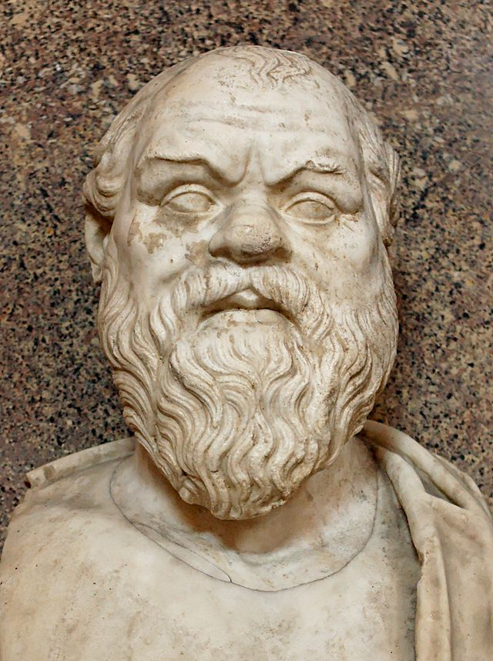
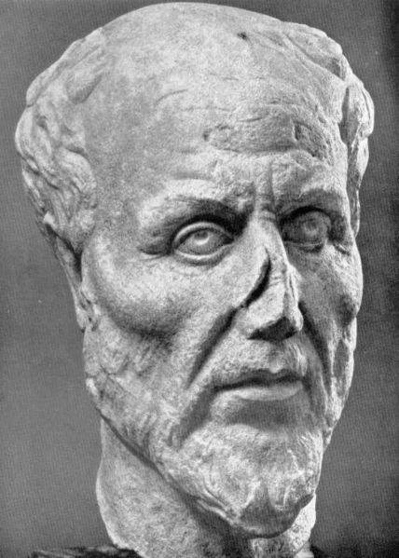
History of The Unconscious
Socrates
Plotinus
Notes:
This slide introduces students to the history of theories of the unconscious mind.
Instructor’s note: Begin the lecture by introducing the extensive history of the unconscious within philosophy. Pictured are sculptures of Socrates (left) and Plotinus (right). This is also a prime opportunity for you to gain information regarding the students’ understanding of and beliefs regarding the unconscious.
Discussion questions:
What do you think the brain does while we think?
Are you aware of when and how your brain is thinking?
Are you able to visualize neurons firing or communicating with one another when you are in deep thought?
Are there examples of things we do everyday that we may not be aware of?
Think about a time you got lost in thought while driving, yet still indicated when you were turning, remembered directions, and even found yourselves home. Did unconscious processes play a role in this example?
After a very brief discussion, tell the students that they have just touched upon the mind-body or conscious vs. unconscious problem.
Explanation: Although the term “unconscious” was only introduced fairly recently (in the 18th century by the German philosopher Platner, the German term being “Unbewusstsein”), the relative “unconsciousness” of human nature has evoked both marvel and frustration for more than two millennia. Socrates (490–399 BC) argued that free will is limited, or at least so it seems, after he noticed that people often do things they really do not want to do. He called this akrasia, which can best be translated as “the lack of control over oneself.” A few centuries later, the Roman thinker Plotinus (AD 205–270) was presumably the first thinker alluding to the possibility of unconscious psychological processes in writing: “The absence of a conscious perception is no proof of the absence of mental activity.”
These two ideas, first verbalized by Socrates and Plotinus respectively, were—and still are—hotly debated in psychology, philosophy, and neuroscience. That is, scientists still investigate the extent to which human behavior is (and/or seems) voluntary or involuntary, and scientists still investigate the relative importance of unconscious versus conscious psychological processes, or mental activity in general. And, perhaps not surprisingly, both issues are still controversial.

Slide 4
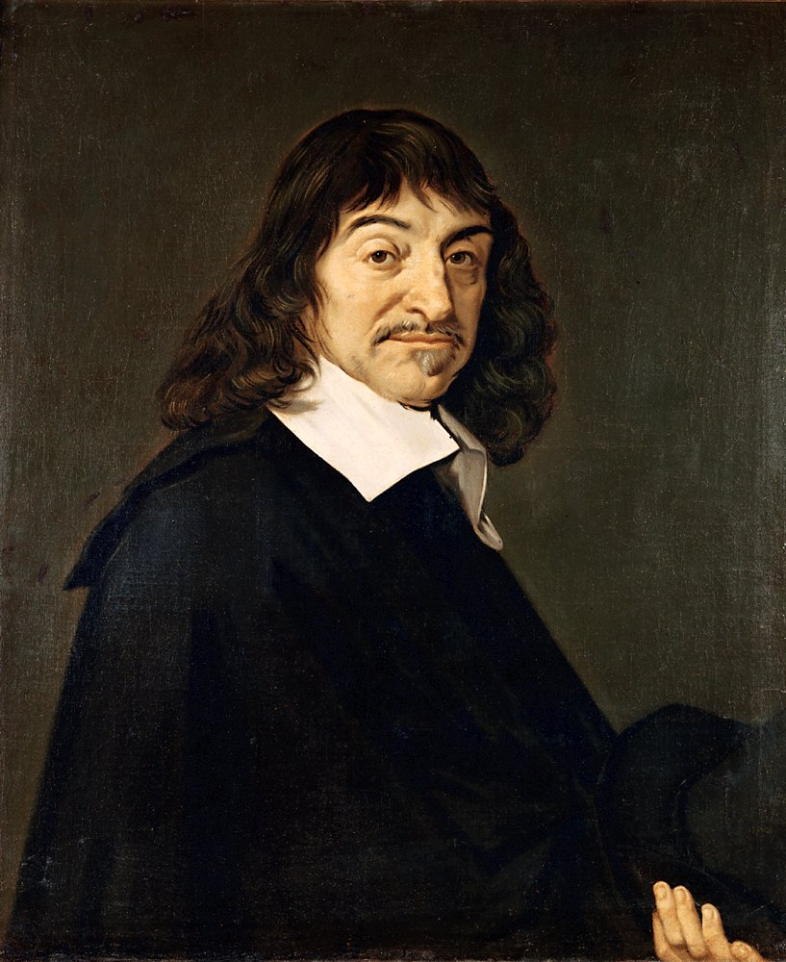
History of The Unconscious
Dualism
Cartesian Catastrophe
Rene Descartes
Notes:
This slide continues the discussion of the history of the unconscious by introducing Descartes’ dualism. The instructor is also to provide information regarding the impact of Dualism on the study of the unconscious, known as the Cartesian Catastrophe.
Activity: How Do You Think About the Mind, Brain, and Behavior? (15-20 minutes) Skip to the last slide, “Appendix A”, for complete instructions and answers.
Historical background: During the scientific revolution in Europe, our unconscious was taken away from us, so to speak, by the French philosopher Descartes (1596–1650). Descartes’s dualism entailed a strict distinction between body and mind. According to Descartes, the mind produces psychological processes and everything going on in our minds is by definition conscious. Some psychologists have called this idea, in which mental processes taking place outside conscious awareness were rendered impossible, the Cartesian catastrophe. It took well over two centuries for science to fully recover from the impoverishment dictated by Descartes.
This is not say that contemporaries of Descartes and later thinkers all agreed with Descartes’s dualism. In fact, many of them disagreed and kept on theorizing about unconscious psychological processes. For instance, the British philosopher John Norris (1657–1711) said: “We may have ideas of which we are not conscious. . . . There are infinitely more ideas impressed on our minds than we can possibly attend to or perceive.” Immanual Kant (1724–1804) agreed: “The field of our sense-perceptions and sensations, of which we are not conscious . . .is immeasurable.” Norris and Kant used a logical argument that many proponents of the importance of unconscious psychological processes still like to point at today: There is so much going on in our brains, and the capacity of consciousness is so small, that there must be much more than just consciousness.

Slide 5
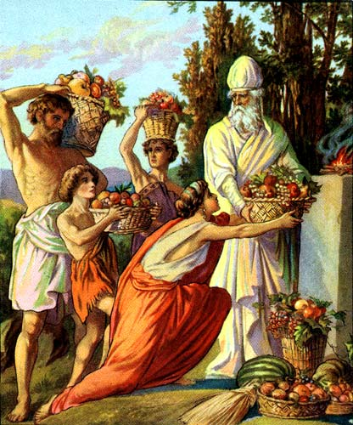
History of The Unconscious
“This unconscious mind is for us like an unknown being who creates and produces for us, and finally throws the ripe fruits in our lap.” – Wilhelm Wundt
Notes:
This slide bring the conversation covered in slides 3 and 4 into the 20th century, exploring the unconscious within the context of Freudian (and Wundtian) theory. The picture alludes to Wilhelm Wundt’s description of the unconscious as “…an unknown being who creates and produces for us, and finally throws the ripe fruits in our lap.”
Historical background: The most famous advocate of the importance of unconscious processes arrived at the scene in the late 19th century: the Austrian neurologist Sigmund Freud. Most people associate Freud with psychoanalysis, with his theory on id, ego, and superego, and with his ideas on repression, hidden desires, and dreams. Such associations are fully justified, but Freud also published lesser-known general theoretical work (e.g., Freud, 1915/1963). This theoretical work sounds, in contrast to his psychoanalytic work, very fresh and contemporary. For instance, Freud already argued that human behavior never starts with a conscious process (compare this to the Libet experiment discussed in slide 6).
Freud, and also Wilhelm Wundt, a German psychologist, pointed at another logical argument for the necessity of unconscious psychological processes. Wundt put it like this: “Our mind is so fortunately equipped, that it brings us the most important bases for our thoughts without our having the least knowledge of this work of elaboration. Only the results of it become conscious. This unconscious mind is for us like an unknown being who creates and produces for us, and finally throws the ripe fruits in our lap.” In other words, we may become consciously aware of many different things—the taste of a glass of Burgundy, the beauty of the Taj Mahal, or the sharp pain in our toe after a collision with a bed—but these experiences do not hover in the air before they reach us. They are prepared, somehow and somewhere. Unless you believe consciousness is causally disconnected from other bodily and mental processes (for instance if one assumes it is guided by the gods), conscious experiences must be prepared by other processes in the brain of which we are not conscious.

Slide 6
History of The Unconscious
Superordinate
“Oak”
Association
Verbal Reply
Notes:
This slide provides detail regarding Watt’s (1905) experiment assessing conscious and unconscious awareness.
Activity:
Explain to students that you are going to say a word, and they are tasked with responding with a superordinate word, or a word that is a more general. For example, if the original word is “rat”, a superordinate word would be “vermin” because a rat is a type of vermin.
Say “Volkswagen” and give students a moment to respond with a superordinate word (car, vehicle, automobile).
Say “ant” and allow students to respond with a superordinate word (insect, bug).
Say “dancing” and wait for students to respond with a superordinate word (moving, exercise).
Now, ask students to think about when they felt themselves having conscious thought.
(Click) Superordinate > “Oak” > Association > Verbal Reply
Historical background/Explanation: ‘The German psychologist Watt (1905), in an appealing experiment, showed that we are only consciously aware of the results of mental processes. His participants were repeatedly presented with nouns (e.g., “oak”) and had to respond with an associated word as quickly as they could. On some occasions participants were requested to name a superordinate word (“oak”-“tree”), while on other occasions they were asked to come up with a part (“oak”-“acorn”) or a subordinate (“oak”-“beam”) word. Hence, participants’ thinking was divided into four stages: the instructions (e.g., superordinate), the presentation of the noun (e.g., “oak”), the search for an appropriate association, and the verbalization of the reply (e.g., “tree”). Participants were asked to carefully introspect on all four stages to shed light on the role of consciousness during each stage. The third stage (searching for an association) is the stage during which the actual thinking takes place and hence this was considered the most interesting stage. However, unlike the other stages, this stage was, as psychologists call it, introspectively blank: Participants could not report anything. The thinking itself was unconscious, and participants were only conscious of the answer that surfaced.

Slide 7
Overview
History of The Unconscious
Origin of Action
Social Psychological Processes
Role of Attention
Notes:
The purpose of this slide is to provide an overview of the material that will be covered during the lecture.

Slide 8
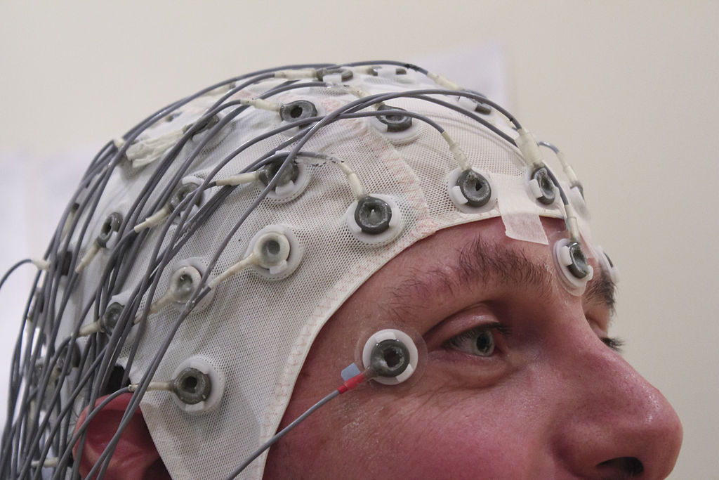
Origin of Action
Unconscious Conscious
Preparation Decisions
Notes:
This slide reviews Kornhuber and Deecke’s (1965) study which utilized EEG methodology to demonstrate that unconscious preparation preceded conscious decisions.
Lecture Info: The idea that we unconsciously prepare an action before we are conscious of this action was tested in one of psychology’s most famous experiments. Quite some time ago, Kornhuber and Deecke (1965) did experiments in which they asked their participants to perform a simple action, in this case flexing a finger. They also measured EEG to investigate when the brain starts to prepare the action. Their results showed that the first sign of unconscious preparation preceded an action by about 800 milliseconds. This is a serious amount of time, and it led Benjamin Libet to wonder whether conscious awareness of the decision to act appears just as long or even longer in advance as well. Libet (1985) replicated the Kornhuber and Deecke experiments while adding another measure: conscious awareness of the decision to act. He showed that conscious decisions follow unconscious preparation and only precede the actual execution of the action by about 200 milliseconds. In other words, the unconscious decides to act; we then become consciously aware of wanting to execute the action, and finally we act.
The experiment by Libet caused quite a stir, and some people tried to save the day for the decisive role of consciousness by criticizing the experiment. Some of this criticism made sense, such as the notion that the action sequence in the Libet experiments does not start with the EEG signals in the brain, but instead before that, with the instruction of the experimenter to flex a finger. And this instruction is consciously perceived. The dust surrounding the precise meaning of this experiment has still not completely settled, and recently Soon and colleagues (Soon, Brass, Heinze, & Haynes, 2008) reported an intriguing experiment in which they circumvented an important limitation of the Libet experiment. Participants had to repeatedly make a dichotomous choice (they were to press one of two buttons) and they could freely choose which one. The experimenters measured participants’ brain activity. After the participants made their simple choice many times, the experimenters could, by looking at the difference in brain activity for the two different choices in earlier trials, predict which button a participant was going to press next up to ten seconds in advance—indeed, long before a participant had consciously “decided” what button to press next.

Slide 9
Overview
History
Origin of Action
Social Psychological Processes
Role of Attention
Notes:
The purpose of this slide is to provide an overview of the material that will be covered during the lecture.

Slide 10
Social Psychological Processes
Mere-exposure Effects – Perceiving a stimulus repeatedly renders it more positive
Notes:
This slide formally introduces two relevant social psychological processes: Mere-exposure Effects and Priming. You will also provide one example of priming to clarify/solidify the students’ understanding of the term. This example will be supplemented with several other priming examples provided in the next slide.
Discussion/warm-up: Ask students what they know about priming. If they have not heard of priming, ask them about their knowledge of subliminal perception.
Explanation: These days, most scientific research on unconscious processes is aimed at showing that people do not need consciousness for certain psychological processes or behaviors. One such example is attitude formation. The most basic process of attitude formation is through mere exposure (Zajonc, 1968).
(Click) Mere-exposure Effects
Merely perceiving a stimulus repeatedly, such as a brand on a billboard one passes every day or a song that is played on the radio frequently, renders it more positive. Interestingly, mere exposure does not require conscious awareness of the object of an attitude. In fact, mere-exposure effects occur even when novel stimuli are presented subliminally for extremely brief durations (e.g., Kunst-Wilson & Zajonc, 1980). Intriguingly, in such subliminal mere-exposure experiments, participants indicate a preference for, or a positive attitude towards, stimuli they do not consciously remember being exposed to.

Slide 11
Overview
History of The Unconscious
Origin of Action
Social Psychological Processes
Role of Attention
Notes:
The purpose of this slide is to provide an overview of the material that will be covered during the lecture.

Slide 12
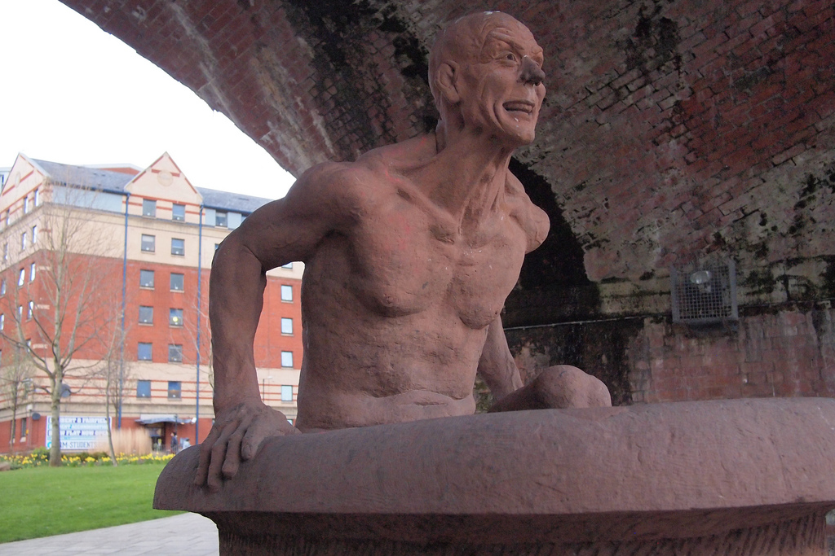
Role of Attention
Eureka Experience – A creative product enters consciousness after an incubation period
Notes:
This slide discusses the role of the unconscious in our understanding of creativity and introduces the concept of a eureka experience.
Instructor’s note: Consider sharing this story of Archimedes: Pictured is a reference to Archimedes famous (and likely mythical) “Eureka” moment, when, having discovered how to measure the volume of an irregular object, Archimedes leaped out of a public bath, and ran home naked shouting "eureka" (meaning “I found it”). Archimedes was asked by the local king to detect whether a crown was pure gold, or if the goldsmith had added silver. During his trip to the public bath, he noticed that water is displaced when his body sinks into the bath, and that the volume of water displaced equals the volume of the body immersed in the water. This means that he can measure the weight of the crown, and compare it to a bar of pure gold.
Discussion question: When you have to work on a complex problem or project for school, do you typically have better luck if you focus only on that problem or project for long periods of time, or does it help you to take breaks, think about other things, and then come back to the task?
Explanation: Insight into unconscious processes has also contributed to our ideas about creativity. Creativity is usually seen as the result of a three-stage process. It begins with attending to a problem consciously. You think and read about a problem and discuss matters with others. This stage allows the necessary information to be gathered and organized, but during this stage a truly creative idea is rarely produced. The second stage is unconscious; it is the incubation stage during which people think unconsciously. The problem is put aside for a while, and conscious attention is directed elsewhere. The process of unconscious thought sometimes leads to a “eureka experience” whereby the creative product enters consciousness. This third stage is one where conscious attention again plays a role. The creative product needs to be verbalized and communicated. For example, a scientific discovery needs detailed proof before it can be communicated to others.

Slide 13
Roles of Attention
Group 1
Presented Info
Made Aware
Distractor Task
Decision Task
Group 2
Presented Info
Not Aware
Distractor Task
Decision Task
Notes:
This slide provides detail regarding a study (Dijksterhuis & Nordgren, 2006) that illustrates the way in which unconscious thought might prove relevant to decision making.
Lecture info: The idea that people think unconsciously has also been applied to decision making (Dijksterhuis & Nordgren, 2006). In a recent set of experiments (Bos, Dijksterhuis, & van Baaren, 2008), participants were presented with information about various alternatives (such as cars or roommates) differing in attractiveness. Subsequently, participants engaged in a distractor task before they made a decision. That is, they consciously thought about something else; in this case, they solved anagrams. However, one group was told, prior to the distractor task, that they would be later asked questions about the decision problem. A second group was instead told that they were done with the decision problem and would not be asked anything later on. In other words, the first group had the goal to further process the information, whereas the second group had no such goal. Results showed that the first group made better decisions than the latter. Although they did the exact same thing consciously—again, solving anagrams—the first group made better decisions than the second group because they first thought unconsciously. Recently, researchers reported neuroscientific evidence for such unconscious thought processes, indeed showing that recently encoded information is further processed unconsciously when people have the goal to do so (Creswell, Bursley, & Satpute, in press).
Discussion question: What do you think about this finding, and have you ever encountered similar experiences in your lives?
Explanation: People are sometimes surprised to learn that we can do so much, and so many sophisticated things, unconsciously. However, it is important to realize that there is no one-to-one relation between attention and consciousness (see e.g., Dijksterhuis & Aarts, 2010). Our behavior is largely guided by goals and motives, and these goals determine what we pay attention to—that is, how many resources our brain spends on something—but not necessarily what we become consciously aware of. We can be conscious of things that we hardly pay attention to (such as fleeting daydreams), and we can pay a lot of attention to something we are temporarily unaware of (such as a problem we want to solve or a big decision we are facing). Part of the confusion arises because attention and consciousness are correlated. When one pays more attention to an incoming stimulus, the probability that one becomes consciously aware of it increases. However, attention and consciousness are distinct. And to understand why we can do so many things unconsciously, attention is the key. We need attention, but for quite a number of things, we do not need conscious awareness.
These days, most researchers agree that the most sensible approach to learn about unconscious and conscious processes is to consider (higher) cognitive operations as unconscious, and test what (if anything) consciousness adds (Dijksterhuis & Aarts 2010; van Gaal, Lamme, Fahrenfort, & Ridderinkhof, 2011; for an exception, see Newell & Shanks, in press). However, researchers still widely disagree about the relative importance or contribution of conscious and unconscious processes. Some theorists maintain that the causal role of consciousness is limited or virtually nonexistent; others still believe that consciousness plays a crucial role in almost all human behavior of any consequence.

Slide 14
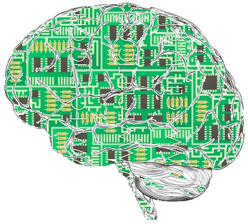
Appendix A
Reversed Items Include:
3, 6, 7, 8, 10, 12, 15, 17, 20, 22, 24 , 25, and 27
To Reverse:
1 = 5
2 = 4
3 = 3
4 = 2
5 = 1
Notes:
Activity: How Do You Think About The Mind, Brain, And Behavior?: In-Class Activity
Time: 15-20 minutes
Materials: Make copies of questionnaire for students to complete (found in IM > Consciousness > Module 2: Unconsciousness > Activities and Demonstrations)
Give the questionnaire to students. Allow 10-15 minutes to complete the questionnaire. Allow a few minutes for discussion.
Scoring instructions: Answers for items 3, 6, 7, 8, 10, 12, 15, 17, 20, 22, 24, 25, and 27 should be reversed. For instance, 1 = 5; 2 = 4; 3 = 3; 4 = 2; 5 = 1. We recommend having this on the board once students have completed the survey. Students should then total the numbers for all the items. Higher scores signify a stronger conviction in dualism and scores can range from 27 to 135.
Notably, American undergraduate students tend to subscribe to dualism, which interestingly enough is at odds with much neuroscientific and psychological research. Additionally, dualism scores were unrelated to religiosity, but positively related to acceptance of ESP (Stanovich, 1989).
Discussion ideas:
One of the questions you can ask the students is if their opinion changed after the class discussion that preceded this activity. See Lecture Frameworks for more details.
If time permits, you can ask volunteers to share some of their responses with the class. Among others, some noteworthy question items are: 4,19, 8 and 22. You can even ask the students which items they found interesting.
Instructor’s note: Feel free to adapt the survey to make it shorter.

Slide 15
Photo Attribution
Slide 1 | Photo Credit: jimmy_bes https://www.flickr.com/photos/31005765@N00/31757843 https://creativecommons.org/licenses/by-nc/2.0/
Slide 5 | Photo Credit: Providence Lithograph Company http://commons.wikimedia.org/wiki/File:Thank_offering_unto_the_Lord.jpg#mediaviewer/File:Thank_offering_unto_the_Lord.jpg http://www.commons.wikimedia.org/wiki/
Slide 4 | Photo Credit: Frans Hals http://commons.wikimedia.org/wiki/File:Frans_Hals_-_Portret_van_Ren%C3%A9_Descartes.jpg#mediaviewer/File:Frans_Hals_-_Portret_van_Ren%C3%A9_Descartes.jpg http://commons.wikimedia.org/wiki/
Slide 3 | Photo Credit: http://commons.wikimedia.org/wiki/File:Socrates_Pio-Clementino_Inv314.jpg#mediaviewer/File:Socrates_Pio-Clementino_Inv314.jpg http://commons.wikimedia.org/wiki/
Slide 3 | Photo Credit: http://upload.wikimedia.org/wikipedia/commons/c/c5/Plotinus.jpg http://en.wikipedia.org/wiki/en:public_domain
Slide 8 | Photo Credit: Chris Hope http://commons.wikimedia.org/wiki/File:EEG_Recording_Cap.jpg#mediaviewer/File:EEG_Recording_Cap.jpg http://creativecommons.org/licenses/by/2.0
Slide 12 | Photo Credit: http://upload.wikimedia.org/wikipedia/commons/2/2f/Eureka_arkimedi.jpg http://en.wikipedia.org/wiki/en:public_domain
Slide 14 | Photo Credit: ArtificialFictionBrain http://commons.wikimedia.org/wiki/File:ArtificialFictionBrain.png http://creativecommons.org/licenses/by/3.0
Notes:
Activity: How Do You Think About The Mind, Brain, And Behavior?: In-Class Activity
Time: 15-20 minutes
Materials: Make copies of questionnaire for students to complete (found in IM > Consciousness > Module 2: Unconsciousness > Activities and Demonstrations)
Give the questionnaire to students. Allow 10-15 minutes to complete the questionnaire. Allow a few minutes for discussion.
Scoring instructions: Answers for items 3, 6, 7, 8, 10, 12, 15, 17, 20, 22, 24, 25, and 27 should be reversed. For instance, 1 = 5; 2 = 4; 3 = 3; 4 = 2; 5 = 1. We recommend having this on the board once students have completed the survey. Students should then total the numbers for all the items. Higher scores signify a stronger conviction in dualism and scores can range from 27 to 135.
Notably, American undergraduate students tend to subscribe to dualism, which interestingly enough is at odds with much neuroscientific and psychological research. Additionally, dualism scores were unrelated to religiosity, but positively related to acceptance of ESP (Stanovich, 1989).
Discussion ideas:
One of the questions you can ask the students is if their opinion changed after the class discussion that preceded this activity. See Lecture Frameworks for more details.
If time permits, you can ask volunteers to share some of their responses with the class. Among others, some noteworthy question items are: 4,19, 8 and 22. You can even ask the students which items they found interesting.
Instructor’s note: Feel free to adapt the survey to make it shorter.

